Slide 1
Environmental Maps

Slide 2
Introduction
Environmental mapping is way to create the appearance of highly reflective surfaces without ray tracing which requires global calculations
Examples: The Abyss, Terminator 2
Is a form of texture mapping
  Supported by OpenGL and Cg
Angel: Interactive Computer Graphics 3E © Addison-Wesley 2002

Slide 3


Example
Angel: Interactive Computer Graphics 3E © Addison-Wesley 2002

Slide 4
Reflecting the Environment
N
V
R
Angel: Interactive Computer Graphics 3E © Addison-Wesley 2002

Slide 5
Mapping to a Sphere
N
V
R
Angel: Interactive Computer Graphics 3E © Addison-Wesley 2002

Slide 6
Hemisphere Map as a Texture
If we map all objects to hemisphere, we cannot tell if they are on the sphere or anywhere else along the reflector
Use the map on the sphere as a texture that can be mapped onto the object
Can use other surfaces as the intermediate
  Cube maps
  Cylinder maps
Angel: Interactive Computer Graphics 3E © Addison-Wesley 2002

Slide 7
Issues
Must assume environment is very far from object (equivalent to the difference between near and distant lights)
Object cannot be concave (no self reflections possible)
No reflections between objects
Need a reflection map for each object
Need a new map if viewer moves
Angel: Interactive Computer Graphics 3E © Addison-Wesley 2002

Slide 8
OpenGL Implementation
OpenGL supports spherical and cube maps
First must form map
  Use images from a real camera
  Form images with OpenGL
Texture map it to object
Angel: Interactive Computer Graphics 3E © Addison-Wesley 2002

Slide 9
Cube Map
Angel: Interactive Computer Graphics 3E © Addison-Wesley 2002

Slide 10
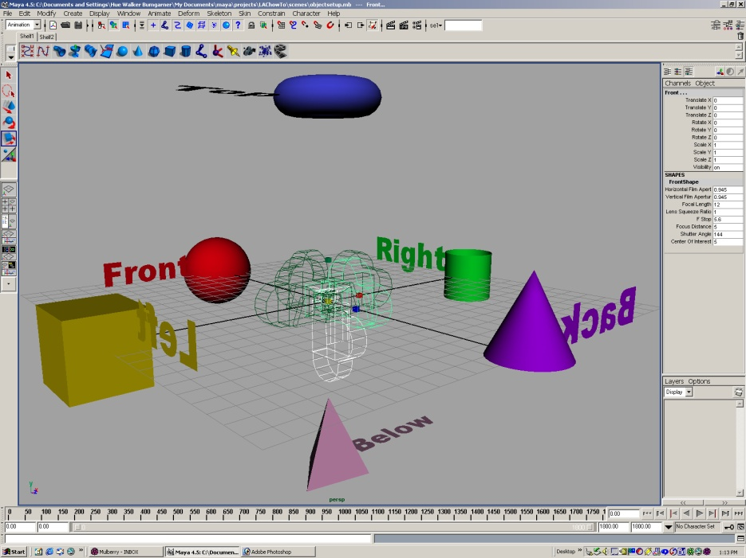
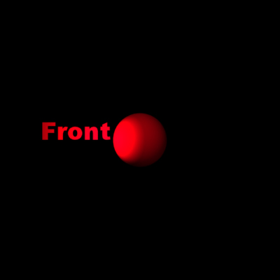

Forming Cube Map
Use six cameras, each with a 90 degree angle of view
Angel: Interactive Computer Graphics 3E © Addison-Wesley 2002

Slide 11
Indexing into Cube Map
Compute R = 2(N·V)N-V
Object at origin
Use largest magnitude component of R to determine face of cube
Other two components give texture coordinates
V
R
Angel: Interactive Computer Graphics 3E © Addison-Wesley 2002

Slide 12
Example
R = (-4, 3, -1)
Same as R = (-1, 0.75, -0.25)
Use face x = -1 and y = 0.75, z = -0.25
Not quite right since cube defined by x, y, z = ± 1 rather than [0, 1] range needed for texture coordinates
Remap by s = ½ + ½ y, t = ½ + ½ z
Hence, s =0.875, t = 0.375
Angel: Interactive Computer Graphics 3E © Addison-Wesley 2002

Slide 13
Doing it in OpenGL
glTextureMap2D(GL_TEXTURE_CUBE_MAP_POSITIVE_X, level, GL_RGBA, rows, columns, border, GL_RGBA, GL_UNSIGNED_BYTE, image1)
Same for other five images
Make one texture object out of the six images
Angel: Interactive Computer Graphics 3E © Addison-Wesley 2002

Slide 14
OpenGL Cube Map (cont)
Parameters apply to all six images
glTEXParameteri(GL_TEXTURE_CUBE_MAP, GL_TEXTURE_MAP_WRAP_S, GL_REPEAT)
Same for t and r
Note that texture coordinates are in 3D space (s, t, r)
Angel: Interactive Computer Graphics 3E © Addison-Wesley 2002

Slide 15
OpenGL Cube Map (cont)
Usually use automatic texture coordinate generation via glTexGen*()
glTexGeni(GL_S, GL_TEXTURE_GEN_MODE, GL_REFLECTION_MAP);
glEnable(GL_TEXTURE_GEN, S);
Same for t and r
glEnable(GL_TEXTURE_CUBE_MAP);
Angel: Interactive Computer Graphics 3E © Addison-Wesley 2002

Slide 16
Normal Mapping
Similar to texture mapping from cube
glTexGeni(GL_S, GL_TEXTURE_GEN_MODE, GL_NORMAL_MAP);
Idea is that we can store normals as textures on cube
Provides fast normal access
Works even if textures are stored at low precision (8 bits/component)
Angel: Interactive Computer Graphics 3E © Addison-Wesley 2002

Slide 17
Texture Objects
Allows us to store more than one texture (the current texture) in texture memory
Texture object stores texels and all parameters
Four steps
  Get name
  Bind
  Check for space (optional)
  Bind and rebind
Angel: Interactive Computer Graphics 3E © Addison-Wesley 2002

Slide 18
Naming Texture Objects
Names are unsigned ints
glGenTextures( GLsize n, Glint *tnames) returns n unused texture names in array tnames
GLuint tnames[10], decal;
glGenTextures(10, tnames);
decal = tnames[0]
Can pass decal to Cg program
Angel: Interactive Computer Graphics 3E © Addison-Wesley 2002

Slide 19
Binding Textures
First call moves object to texture memory
Subsequent calls make this object the current texture
glBindTexture(GLenum target, GLuint tname)
glBindTexture(GL_TEXTURE_CUBE_
MAP, decal)
Can also prioritize, check if space available, and delete
Angel: Interactive Computer Graphics 3E © Addison-Wesley 2002

Slide 20
Passing Texture Objects to Cg
From earlier fragment program example
void FragmentProgram(
in float4 color : COLOR0,
in float4 texCoord: TEXCOORD0,
out floar4 color0: COLOR0,
const uniform sampler2D BaseTexture,
const uniform float4 SomeColor) {
Color0 = color * tex2D(BaseTexture, texCoord) + SomeColor;
Angel: Interactive Computer Graphics 3E © Addison-Wesley 2002

Slide 21
Parameter Passing (OpenGL)
GLuint texture; /* texture object name */
CGparameter baseTexture, someColor
baseTexture = cgGetNamedParameter(fragmentProgram,
“BaseTexture”);
someColor = cgGetNamedParemeter(fragmentProgram,
“SomeColor”);
cgGLSetTextureParameter(baseTexture, texture);
cgGLEnableTextureParameter(baseTexture);
Angel: Interactive Computer Graphics 3E © Addison-Wesley 2002

Slide 22
Cg Example (vertex program)
void C7E1v_reflection(float4 position : POSITION,
float2 texCoord : TEXCOORD0,
float3 normal : NORMAL,
out float4 oPosition : POSITION,
out float2 oTexCoord : TEXCOORD0,
out float3 R : TEXCOORD1,
uniform float3 eyePositionW,
uniform float4x4 modelViewProj,
uniform float4x4 modelToWorld)
{
Angel: Interactive Computer Graphics 3E © Addison-Wesley 2002

Slide 23
Vertex program (cont)
oPosition = mul(modelViewProj, position);
oTexCoord = texCoord;
// Compute position and normal in world space
float3 positionW = mul(modelToWorld, position).xyz;
float3 N = mul((float3x3)modelToWorld, normal);
N = normalize(N);
// Compute the incident and reflected vectors
float3 I = positionW - eyePositionW;
R = reflect(I, N);
}
Angel: Interactive Computer Graphics 3E © Addison-Wesley 2002

Slide 24
Cg Example (fragment program)
void C7E2f_reflection(float2 texCoord : TEXCOORD0,
float3 R : TEXCOORD1,
out float4 color : COLOR,
uniform float reflectivity,
uniform sampler2D decalMap,
uniform samplerCUBE environmentMap)
{
Angel: Interactive Computer Graphics 3E © Addison-Wesley 2002

Slide 25
fragment program (cont)
// Fetch reflected environment color
float4 reflectedColor = texCUBE(environmentMap, R);
// Fetch the decal base color
float4 decalColor = tex2D(decalMap, texCoord);
color = lerp(decalColor, reflectedColor, reflectivity);
}
Angel: Interactive Computer Graphics 3E © Addison-Wesley 2002

Slide 26
Spherical Map
Original environmental mapping technique proposed by Blinn and Newell
Angel: Interactive Computer Graphics 3E © Addison-Wesley 2002

Slide 27
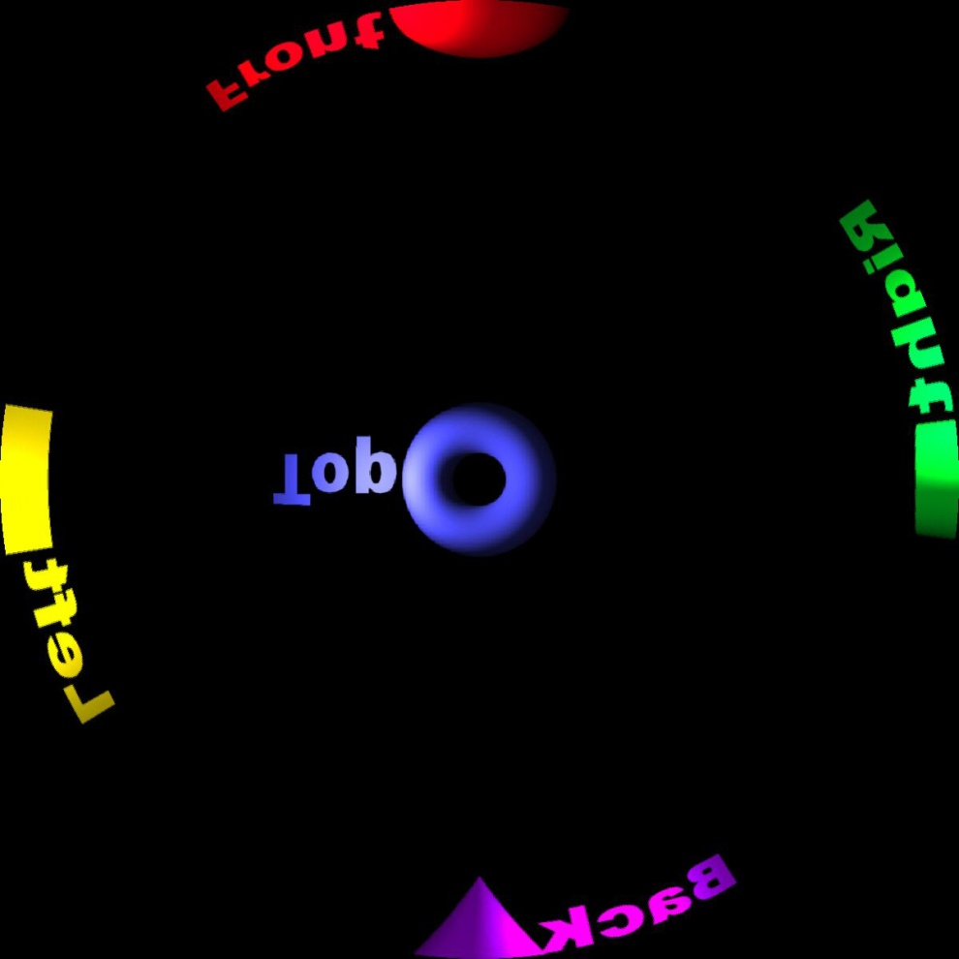
Spherical Map
Angel: Interactive Computer Graphics 3E © Addison-Wesley 2002

Slide 28
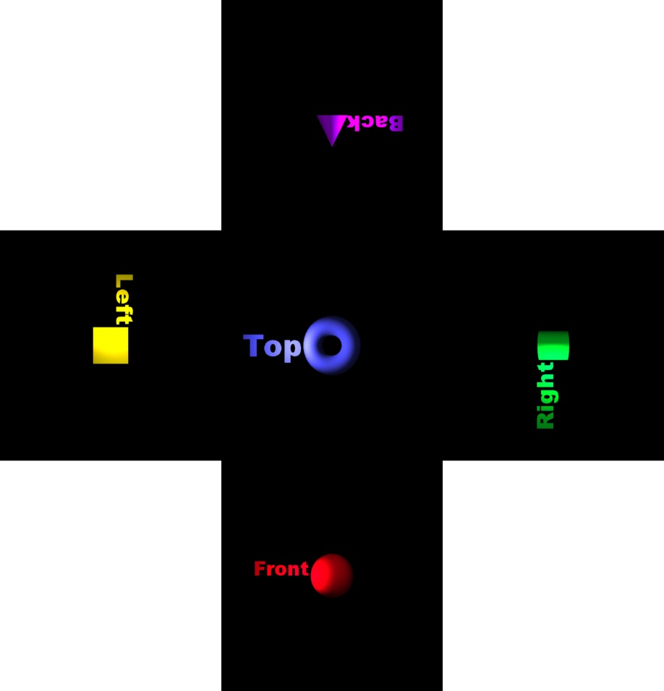
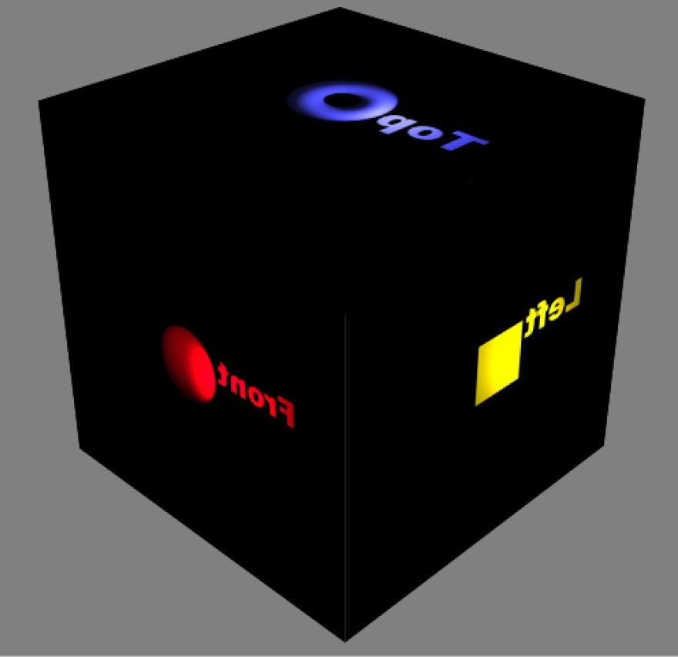
Unraveled
Angel: Interactive Computer Graphics 3E © Addison-Wesley 2002

Slide 29
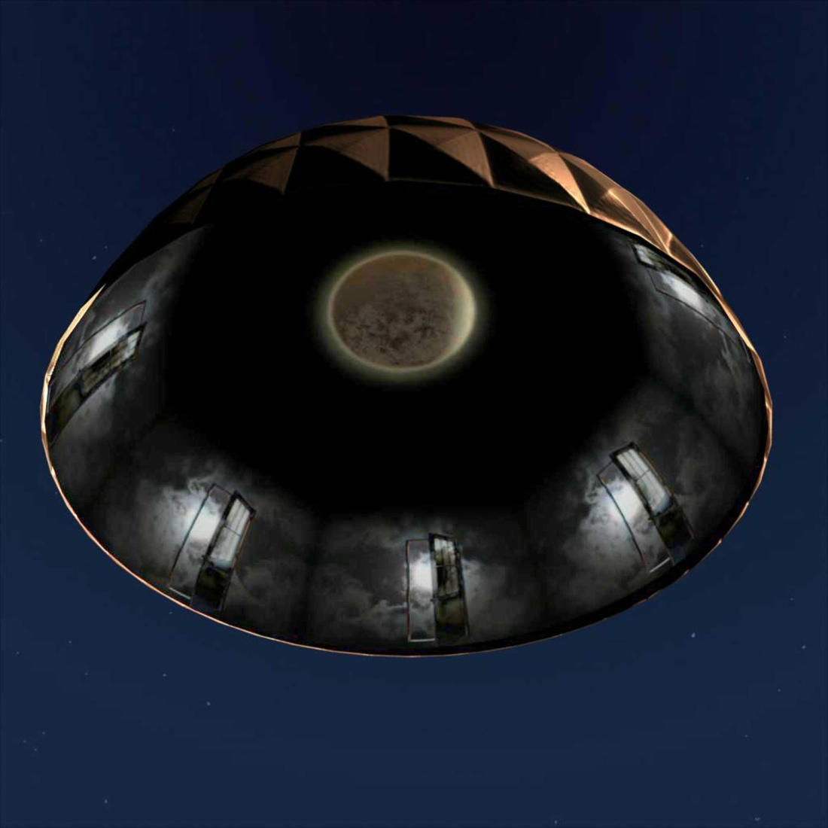
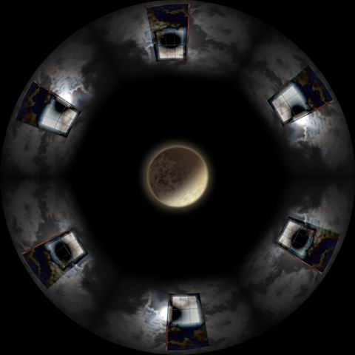
Dome Master and Final Image
Angel: Interactive Computer Graphics 3E © Addison-Wesley 2002

Slide 30
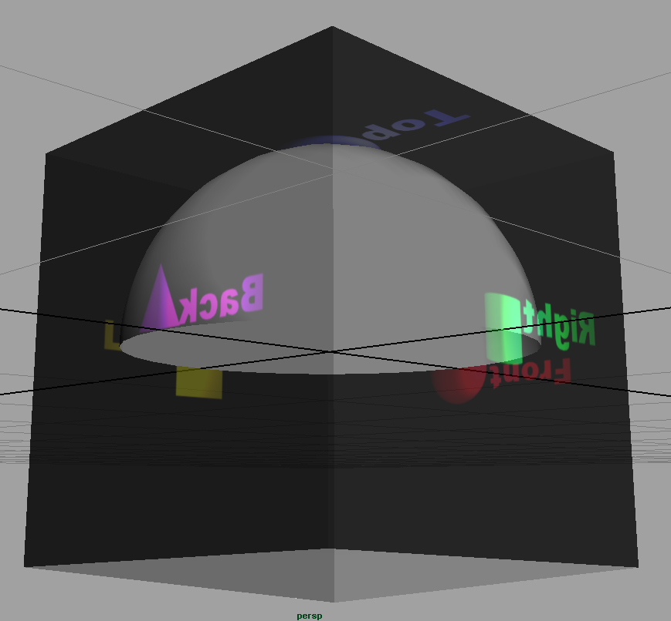
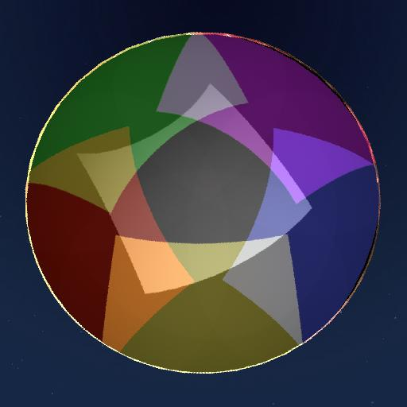
Slicing
Dome Master sequence is sliced, feathered, and gamma corrected for 6 projector system
Angel: Interactive Computer Graphics 3E © Addison-Wesley 2002

